Slide 1
Data Structures and Algorithms Design
Febin.A.Vahab
2019-20

Slide 2
Qn1:Traversal
    If the inorder traversal of a binary tree prints nodes labelled C D E N P X Y and the post order traversal of binary tree prints nodes labelled D C E P Y X N, then what sequences of labels does the pre order traversal print?
Page <number>

Slide 3
Qn1:Traversal-ANSWER
    Inorder traversal -C D E N P X Y
    Post order traversal - D C E P Y X N
    We first find the last node in postorder. The last node is “N”, we know this value is root as root always appear in the end of postorder traversal.
    We search “N” in inorder to find left and right subtrees of root. Everything on left of “N” in inorder is in left subtree and everything on right is in right subtree.
Page <number>

Slide 4
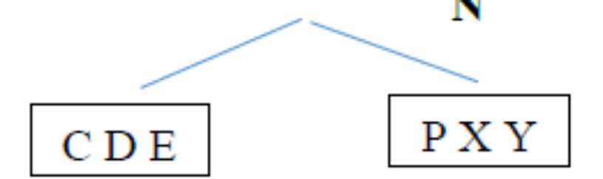
Qn1:Traversal-ANSWER
    Inorder traversal -C D E N P X Y
    Post order traversal - D C E P Y X N
    N
Page <number>

Slide 5
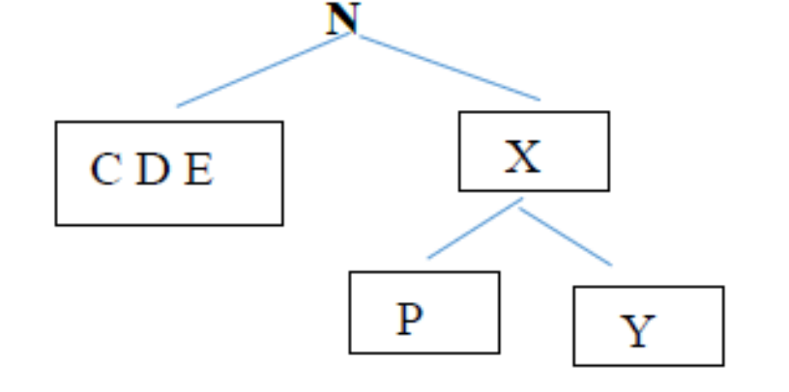
Qn1:Traversal-ANSWER
    Inorder traversal -C D E N P X Y
    Post order traversal - D C E P Y X N
We recur the above process for following
Recur for in = {P,X,Y} and post = {P,Y,X}
Make the created tree as right child of root
Page <number>

Slide 6
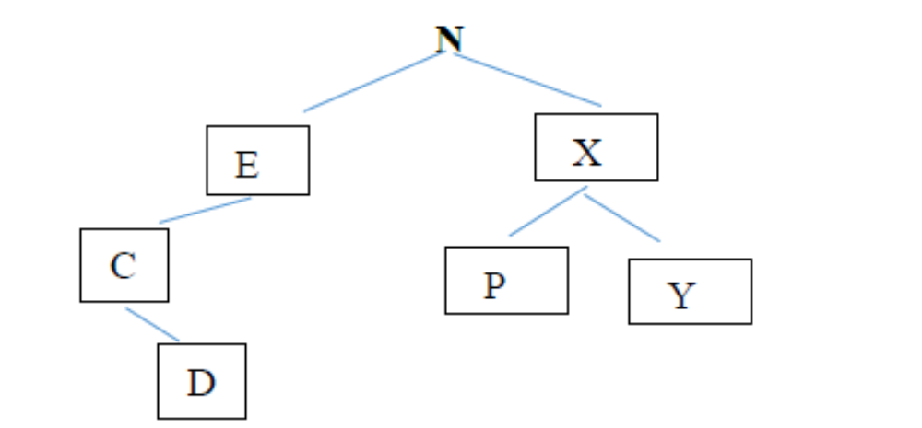
Qn1:Traversal-ANSWER
    Inorder traversal -C D E N P X Y
    Post order traversal - D C E P Y X N
Recur for in = {C,D,E} and post = {D,C,E}
Page <number>

Slide 7
Qn1:Traversal-ANSWER
    Inorder traversal -C D E N P X Y
    Post order traversal - D C E P Y X N
ANSWER: N E C D X P Y
Page <number>

Slide 8
Qn2:INSERTION & SEARCH
Prof X is standing at the door of his classroom. There are currently N students in the class, i th student got A_{i} candies. There are still M more students to come. At every instant, a student enters the class and wishes to be seated with a student who has exactly the same number of candies. For each student, Professor shouts YES if such a student is found, NO otherwise. Even if the student entering the class can't find a partner with equal no. of candies, he will still enter the class and be seated.
Identify a data structure to implement the above problem statement.
Page <number>

Slide 9
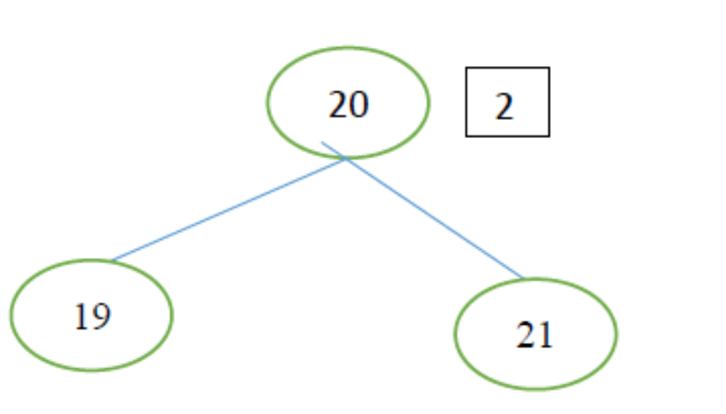
Qn2:INSERTION & SEARCH-Answer
Page <number>

Slide 10
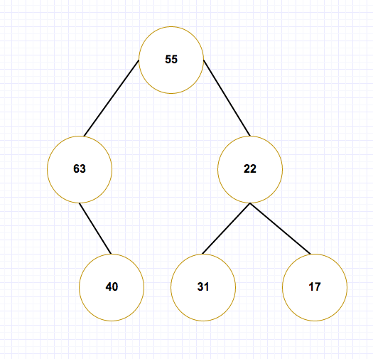
Qn3:
Suppose the keys 55,63,31,17,22,40 are inserted into a binary tree in that order. Which of the following is the BST that is formed?
Page <number>

Slide 11
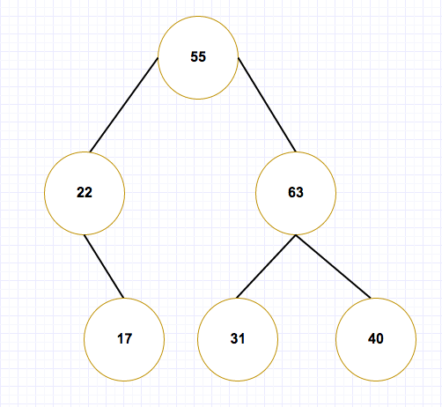
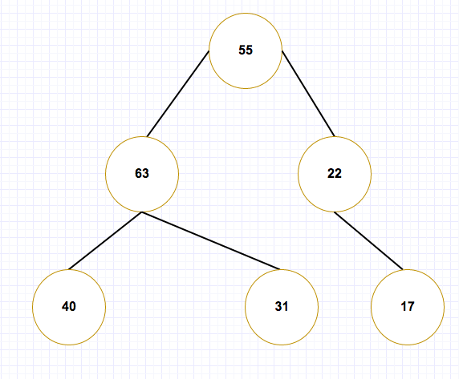
Qn3 :
Page <number>

Slide 12
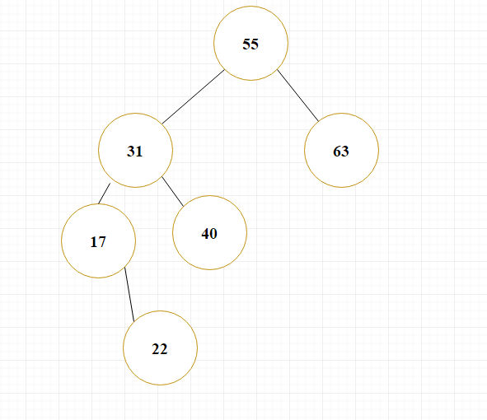
Qn3 :
Page <number>

Slide 13
Qn4:LCA
Given a binary search tree and two values say n1 and n2, write a program to find the least common ancestor. You may assume that both the values exist in the tree.
Page <number>

Slide 14
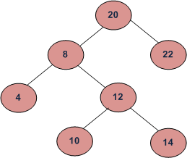
LCA-ANSWER
LCA of 10 and 14 is 12
LCA of 14 and 8 is 8
LCA of 10 and 22 is 20
Page <number>

Slide 15
Qn4:LCA-ANSWER
Let T be a rooted tree. The lowest common ancestor between two nodes n1 and n2 is defined as the lowest node in T that has both n1 and n2 as descendants (where we allow a node to be a descendant of itself).
    The LCA of n1 and n2 in T is the shared ancestor of n1 and n2 that is located farthest from the root.
Page <number>

Slide 16
Qn4:LCA-ANSWER
We can solve this problem using BST properties. We can recursively traverse the BST from root.
The main idea of the solution is, while traversing from top to bottom, the first node n we encounter with value between n1 and n2, i.e., n1 < n < n2 or same as one of the n1 or n2, is LCA of n1 and n2 (assuming that n1 < n2).
So just recursively traverse the BST, if node’s value is greater than both n1 and n2 then our LCA lies in left side of the node, if it’s is smaller than both n1 and n2, then LCA lies on right side. Otherwise root is LCA (assuming that both n1 and n2 are present in BST)
Page <number>

Slide 17
Qn4:LCA-ANSWER
Time complexity of above solution is O(h) where h is height of tree.
Page <number>

Slide 18
Qn5:Sucessor and Predecessor
In a Binary Search Tree, the successor of a given key is the smallest number which is larger than the key. In the same way, a predecessor is the largest number which is smallest than the key. Write an algorithm (with pseudocode) to find the successor and predecessors of a given key.
Page <number>

Slide 19
Qn5:Sucessor ANSWER
    If right subtree of node is not NULL,then successor lies in right subtree.
      Go to right subtree and return the node with minimum key vaue in the right subtree.
If right subtree of node is NULL, then succ is one of the ancestors.
  Start from root.
  Travel down the tree, if the node’s data is greater than root, go right side
  Otherwise go to left side.
Page <number>

Slide 20
Qn5:Sucessor -ANSWER
    If(x.right!=NULL)
    return minValue(x.right)
    else
    While root!=NULL
    if(x<root.data)
    succ=root
    root=root.left
    else if(x>root.data)
    root=root.right
    else exit loop.
    Return succ.
Page <number>

Slide 21
Qn5:Sucessor and Predecessor-ANSWER
    Method 2
    1) If right subtree of node is not NULL, then succ lies in right subtree. Do following.
    Go to right subtree and return the node with minimum key value in right subtree.
    2) If right sbtree of node is NULL, then succ is one of the ancestors. Do following.
    Travel up using the parent pointer until you see a node which is left child of it’s parent. The parent of such a node is the succ.
Page <number>

